Slide 1
Variational Autoencoders
FINAL PROJECT
Course: Machine Learning
Student: Lilit Beglaryan
Instructor: Khoren Petrosyan
Date: 2023, May
Notes:
https://arxiv.org/pdf/1606.05908.pdf
https://arxiv.org/pdf/1502.04623.pdf
https://arxiv.org/pdf/1602.05473.pdf
https://arxiv.org/pdf/1511.06349.pdf
http://blog.fastforwardlabs.com/2016/08/12/introducing-variational-autoencoders-in-prose-and.html
http://blog.fastforwardlabs.com/2016/08/22/under-the-hood-of-the-variational-autoencoder-in.html
https://ermongroup.github.io/cs228-notes/extras/vae/
http://kvfrans.com/variational-autoencoders-explained/
https://stats.stackexchange.com/questions/267924/explanation-of-the-free-bits-technique-for-variational-autoencoders
http://szhao.me/https://www.cs.princeton.edu/courses/archive/spring17/cos598E/Ghassen.pdf
2017/06/10/a-tutorial-on-mmd-variational-autoencoders.html
https://www.jeremyjordan.me/variational-autoencoders/
שקף 40 – לבדוק האם בכלל נחוץ
לעשות מעבר ברור יותר אחרי הparameterization trick
לבדוק את המתמטיקה ולהוסיף שלבים שיהיה ברור יותר
מה בדיוק intractable – P(x) או P(x|z) או אחרים?
חוסר אחידות – לפעמים posterior ולפעמים likelihood
לתת דגש על איך אני עושה את ה-Image Generation אחרי הכל
אינטואיציה לcross entropy – אין וצריך
את האנימציה של L – להבין היטב. מה ה-KL מייצג שם?

Slide 2
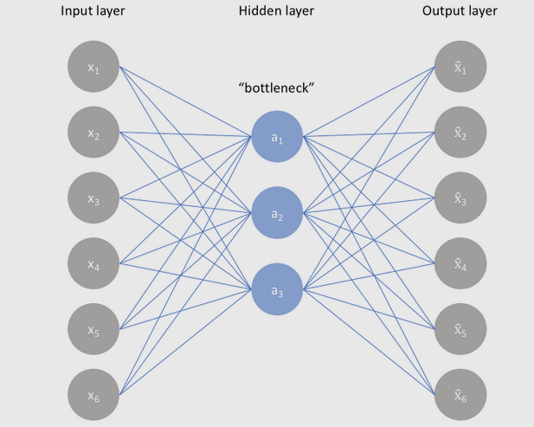
Autoencoders
Traditional AE are models designed to output a reconstruction of their input by deconstructing input data into hidden representations, then constructing the latency space, reconstructing samples from that space
The appeal of this setup is that the model learns its own definition of a salient representation based only on data – no labels or heuristics(unsupervised learning)

Slide 3
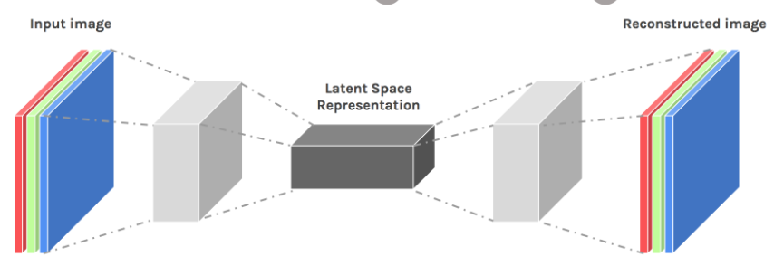
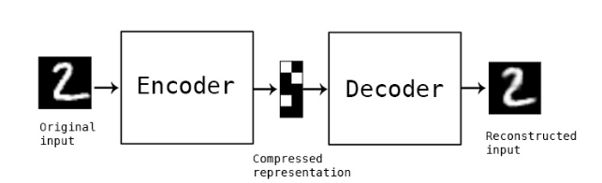
Structure of AEs

Slide 4

Variational Autoencoders
Loss
A probabilistic twist on autoencoders that enables:
Novel image(or text,etc.) synthesis from random samples
Transition from image to image or from mode to mode
Aggregation of similar images to close locations in the latent space
Loss = Reconstruction Loss – KL divergence(ensuring that the distribution we are learning (the latent distribution) is not too far from Normal Gaussian with mean 0 and std 1)
*** If the input slightly differs from the training set —> reconstruction loss high, because latent space is ill-defined in that case

Slide 5
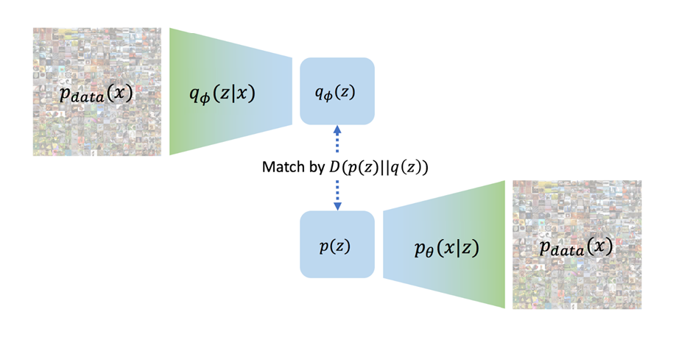
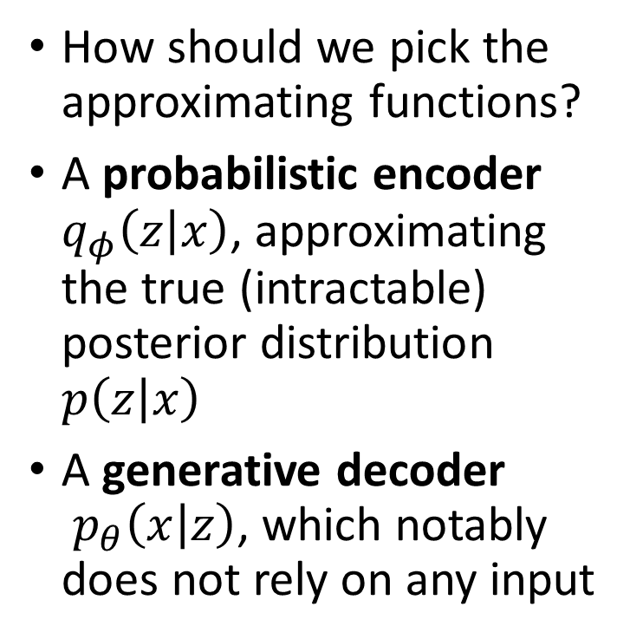
Probability functions
How should we pick the approximating functions?
A probabilistic encoder $q_{φ}\left(z | x\right)$, approximating the true (intractable) posterior distribution $p\left(z | x\right)$
A generative decoder $p_{θ}\left(x | z\right)$, which notably does not rely on any input

Slide 6
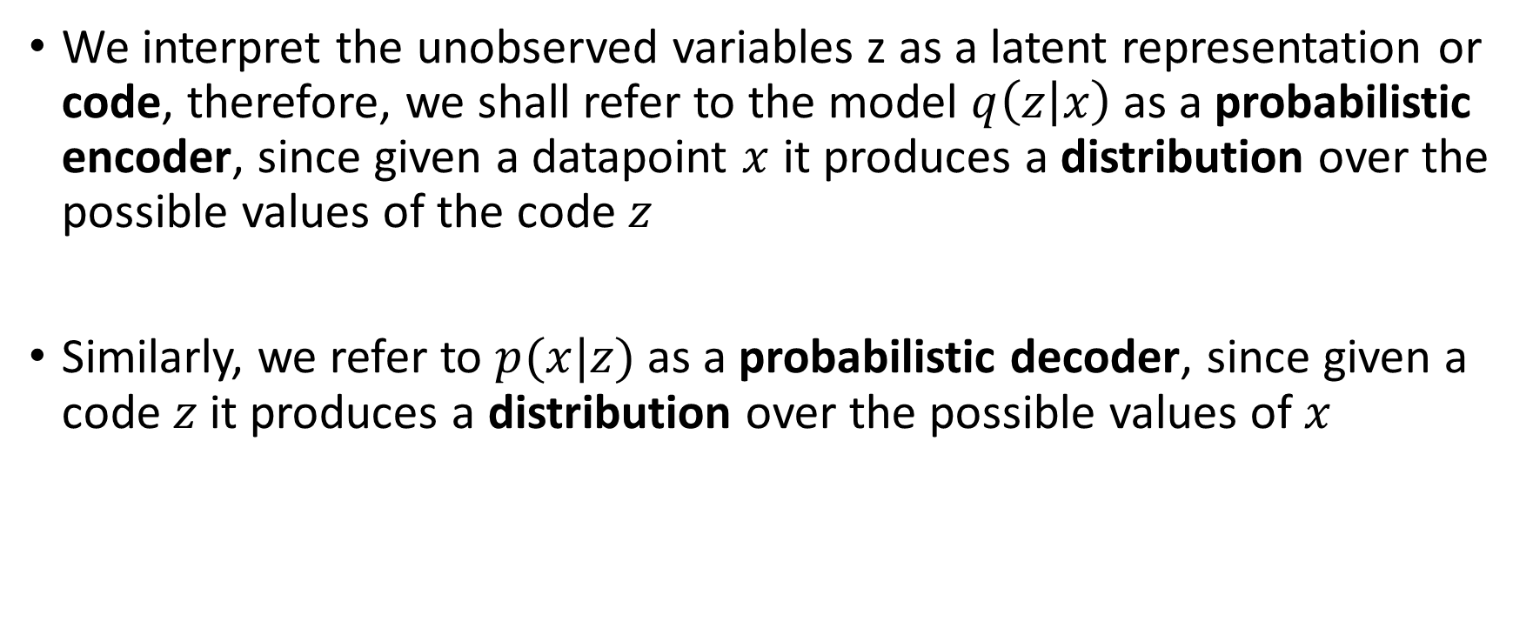
Information Theory
We interpret the unobserved variables z as a latent representation or code, therefore, we shall refer to the model $q\left(z | x\right)$ as a probabilistic encoder, since given a datapoint $x$ it produces a distribution over the possible values of the code $z$
Similarly, we refer to $p(x|z)$ as a probabilistic decoder, since given a code $z$ it produces a distribution over the possible values of $x$

Slide 7
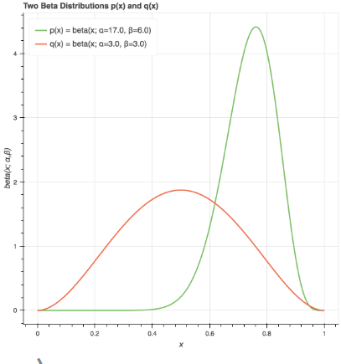

Kullback–Leibler Divergence
Let’s define a measure of similarity between distributions $p$ and $q$
How about:
$$KL(p|\left|q\right)≟H\left(q\right)−H(p)$$
However, we take the expectation with respect to $p$ and obtain
$$KL(p|\left|q\right)=H_{c}\left(p,q\right)−H(p)=∑{p\left(x\right)log{p\left(x\right)}−∑{p\left(x\right)\log{q\left(x\right)}}}$$
During training, we are minimising the loss function= MSE (output – input) +KL(myu, sigma)
Notes:
KL-Divergence measures the average number of EXTRA bits per message to encode them

Slide 8
Usage
Variational Autoencoders are a deep learning technique for unsupervised learning useful latent representations
VAEs as a tool to do: ▸ Anomaly / outlier detection ▸ Noise reduction ▸ Generative modelling ▸ Event generation with a density buffer

Slide 9
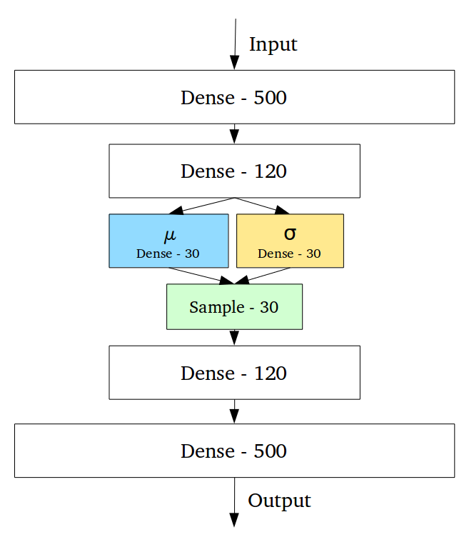
Architecture
Very similar to the regular autoencoder
The probabilistic nature of the VAE is enabled using a sampling layer

Slide 10
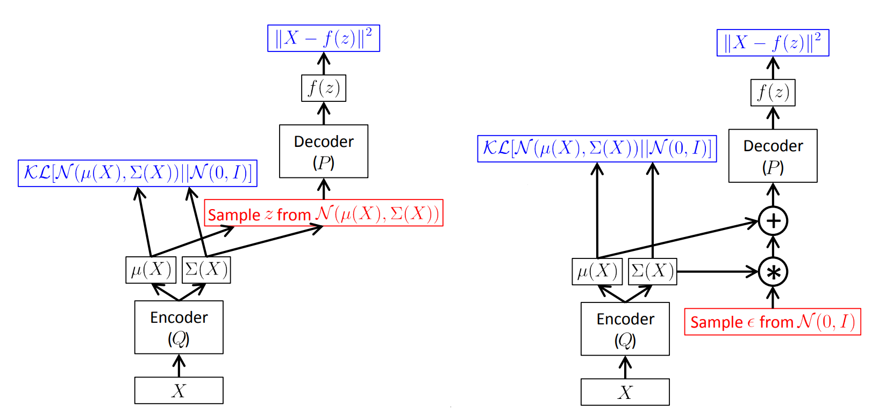
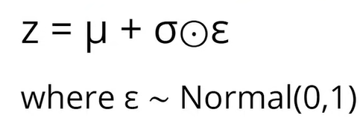
Back-Propagation through Random Operations Reparametrization Trick
Notes:
Epsilon is a stochastic node, we resample many epsilons from satdnard gaussian, but what we want to train is the mean and sigma std, so we don’t need to resample the epsilons. Reparam –trick – split the architecture into parts where the backpropagation can be done and the stochastic epsil sampling part where not. This sampling is from the latent distributions which will later be used by KL divergence to calculate the loss and then again the gradient will be calculated wrt. Mean and std and again backproagated

Slide 11
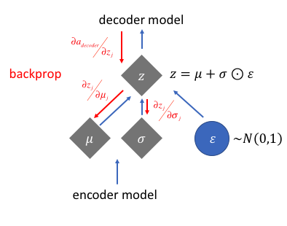
Back-Propagation through Random Operations

Slide 12
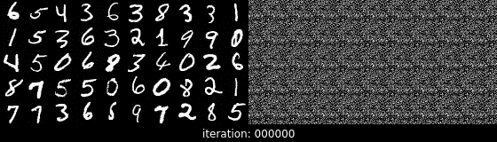
Denoising Autoencoders
identifies and removes noise from your data
Neural Inpainting( cropping a portion of the image or adding scars, it will recover the missing pixels)

Slide 13

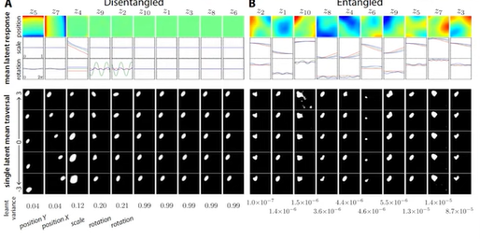
Alternative Autoencoders
Loss
Disentangled AE vs Entangled AE
Loss = Reconstruction Loss – KL divergence(ensuring that different neurons in the latent distributions are disentangled, uncorrelated such that they all learn different things from the input data)
Notes:
To extract very useful causal features from high Dimen data and using them to learn tasks, generalizing out of the train data, disentangling less(the smaller the beta coefficient) the more difficult to generalize(high chances of overfittig), and when beta is too big, disentangling heavily, lose high definition details and undefitting.

Slide 14
Example of Entangled AE

Slide 15
VAE Drawbacks
Approximate Inference: VAEs rely on approximate inference methods, such as variational inference, which introduces an approximation error.
Blurriness in Generated Samples: VAEs often produce blurry or less sharp samples compared to other generative models. This blurriness can be attributed to the use of the reparameterization trick during training, which introduces random noise into the latent space.
Difficulty Capturing High-Frequency Details: VAEs tend to struggle in capturing high-frequency details present in the data. This limitation is related to the blurriness issue and can make it challenging to generate samples with intricate or fine-grained features.
Limited Control over Generated Samples: VAEs do not provide explicit control over the generation process. As VAEs model the data distribution as a whole, it can be challenging to manipulate specific attributes or features of the generated samples. Other generative models, such as Generative Adversarial Networks (GANs), may offer more control over generated outputs.
Sensitivity to Hyperparameters: VAEs are sensitive to the choice of hyperparameters, such as the dimensionality of the latent space, the balance between reconstruction loss and KL divergence term, and the architecture of the encoder and decoder networks.
Notes:
GANs- the generator tries to generate realistic samples, while the discriminator tries to distinguish between real and generated samples. GANs have been successful in generating high-quality and diverse samples but may be more challenging to train compared to VAEs.

Slide 16

Advantages
Probabilistic spin to traditional autoencoders
Defines an intractable distribution and optimizes a variational lower bound
Allows data generation and a useful latent representation
Training is faster than in alternatives, due to Reparametrization Trick(efficient gradient calculations), KL regularization(helps to speed up the convergence)

Slide 17
THANK YOU !

